Slide 1

DAY 07
Chapter 9 Pointers Review, Chapter 10 Strings,
Chapter 11 Structs.
1

Slide 2
QUICK REVIEW
2

Slide 3
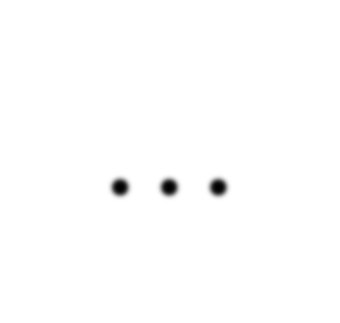
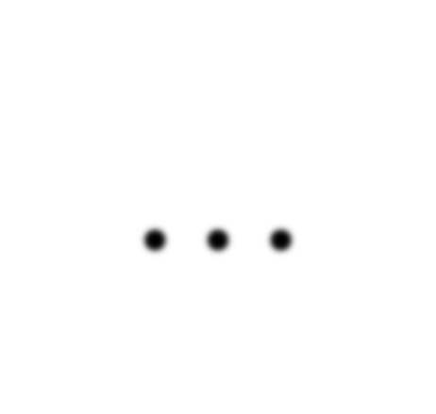
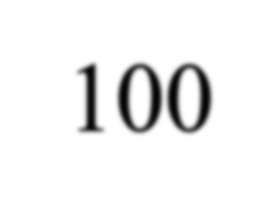
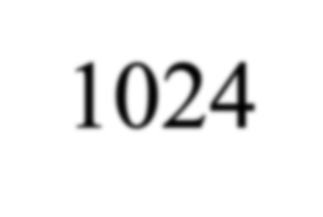
Computer Memory
int a = 100;
Memory address:
1020
1024
1032
… | … | 100 | … | 1024 | …
a
Variable a’s value, i.e., 100, is stored at memory location 1024
3

Slide 4
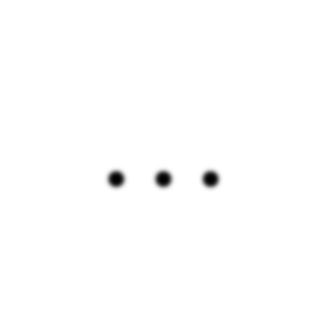
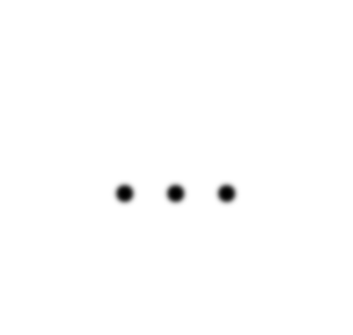
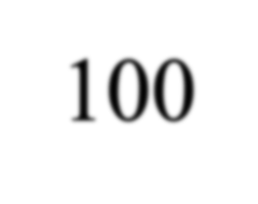
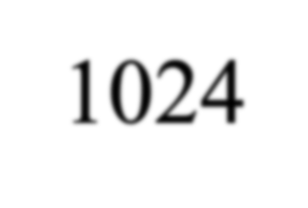
Pointers
Memory address:
1020
1024
1032
…
…
100
…
1024
…
integer
pointer
4

Slide 5
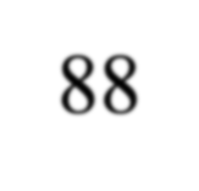
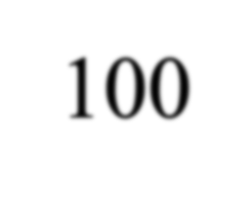
Address Operator &
Memory address:
1020
1024
1032
…
88
100
…
…
…
a
#include <iostream>
using namespace std; void main(){
int a, b; a = 88;
b = 100;
b
cout << "The | address | of a is: | " << | &a | << endl;
cout << "The | address | of b is: | " << | &b | << endl;
}
5

Slide 6
Address Operator &
Memory address:
1020
1024
1032
…
88
100
…
…
…
a
#include <iostream>
using namespace std; void main(){
int a, b; a = 88;
b = 100;
b
Result is:
The address of a is: 1020 The address of b is: 1024
cout << "The | address | of a is: | " << | &a << endl;
cout << "The | address | of b is: | " << | &b << endl;
}
6

Slide 7
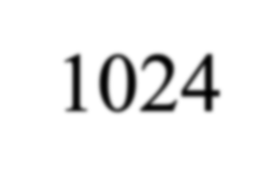
Pointer Variables
Memory address:
1020
1024
1032
… | 88 | 100 | … | 1024 | …
a
p
int a = 100; int *p = &a;
cout << a << " " << &a <<endl; cout << p << " " << &p <<endl;
• The value of pointer p is the address of variable a
• A pointer is also a variable, so it has its own memory address
7

Slide 8
Pointer Variables
Memory address:
1020
1024
1032
… | 88 | 100 | … | 1024 | …
a
p
int a = 100; int *p = &a;
cout << a << " " << &a <<endl; cout << p << " " << &p <<endl;
Result is:
100 1024
1024 1032
• The value of pointer p is the address of variable a
• A pointer is also a variable, so it has its own memory address
8

Slide 9
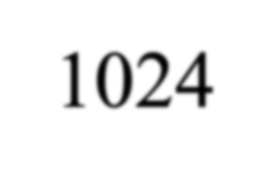
Dereferencing Operator *
We can access to the value stored in the variable pointed to by using the dereferencing operator (*),
Memory address:
1020
1024
1032
… | 88 | 100 | … | 1024 | …
int a = 100; int *p = &a;
cout << a << endl; cout << &a << endl;
a
p
cout | << | p << " " << | *p << | endl;
cout | << | &p << endl;

Slide 10
Dereferencing Operator *
We can access to the value stored in the variable pointed to by using the dereferencing operator (*),
Memory address:
1020
1024
1032
… | 88 | 100 | … | 1024 | …
int a = 100; int *p = &a;
cout << a << endl; cout << &a << endl;
a
p
Result is:
100
1024
1024 100
1032
cout | << | p << " " << | *p << | endl;
cout | << | &p << endl;

Slide 11
Don’t get confused
Declaring a pointer means only that it is a pointer: int *p;
Don’t be confused with the dereferencing operator, which is also written with an asterisk (*). They are simply two different tasks represented with the same sign
int a = 100, b = 88, c = 8; int *p1 = &a, *p2, *p3 = &c;
p2 = &b; p2 = p1; b = *p3;
*p2 = *p3;
// p2 points to b
// p2 points to a
//assign c to b
//assign c to a
cout << a << b << c;

Slide 12
Don’t get confused
Declaring a pointer means only that it is a pointer: int *p;
Don’t be confused with the dereferencing operator, which is also written with an asterisk (*). They are simply two different tasks represented with the same sign
*, operates on a pointer variable. It returns the location value in memory pointed to by the variable's value.
int x; int *p;
Here, the asterisk tells the compiler, "p is not an integer, but rather a pointer to a location in memory which holds an integer." Here, it is not a dereference, but part of a pointer declaration.
p = &x;
This action tells the compiler, "The address in memory that p points to is the address that you allocated for the integer x."

Slide 13
Don’t get confused
Declaring a pointer means only that it is a pointer: int *p;
Don’t be confused with the dereferencing operator, which is also written with an asterisk (*). They are simply two different tasks represented with the same sign
int a = 100, b = 88, c = 8; int *p1 = &a, *p2, *p3 = &c;
p2 = &b; | // p2 points | to | b
p2 = p1; | // p2 points | to | a
b = *p3;
*p2 = *p3;
//assign c to b
//assign c to a
Result is:
888
cout << a << b << c;

Slide 14
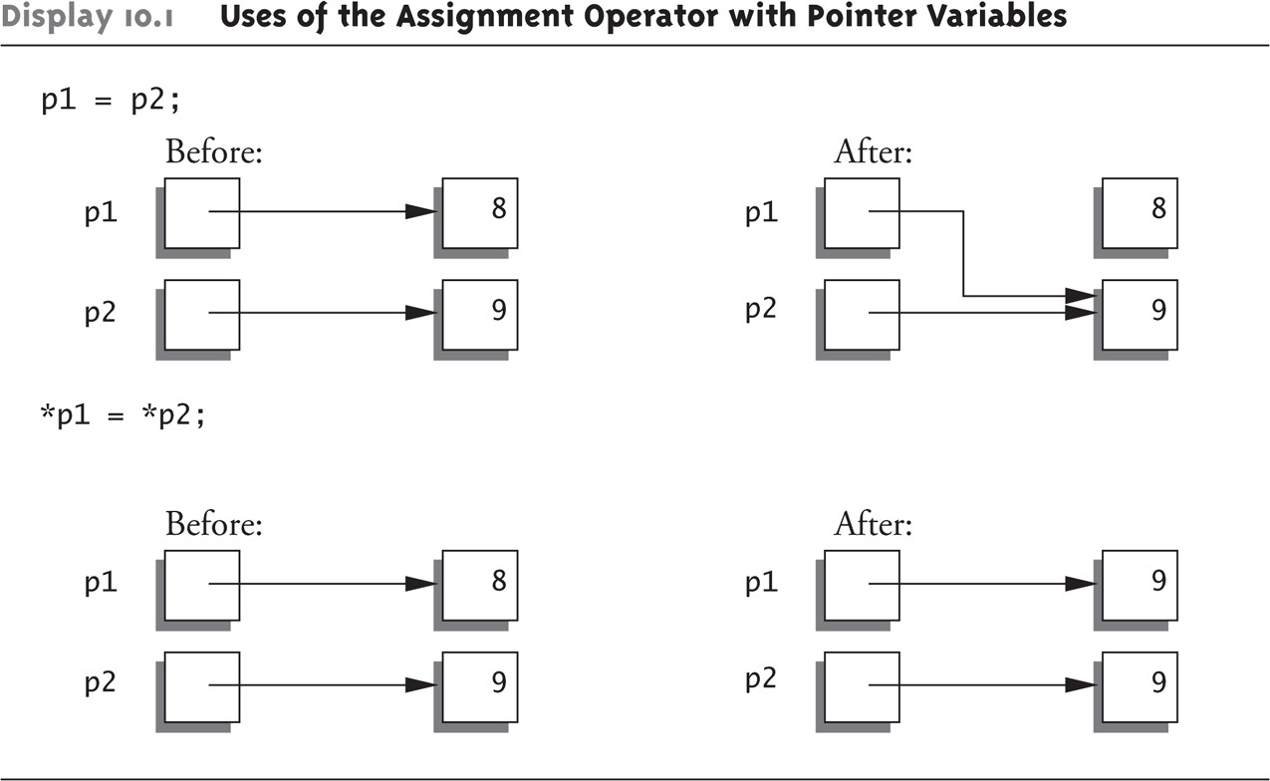

Slide 15
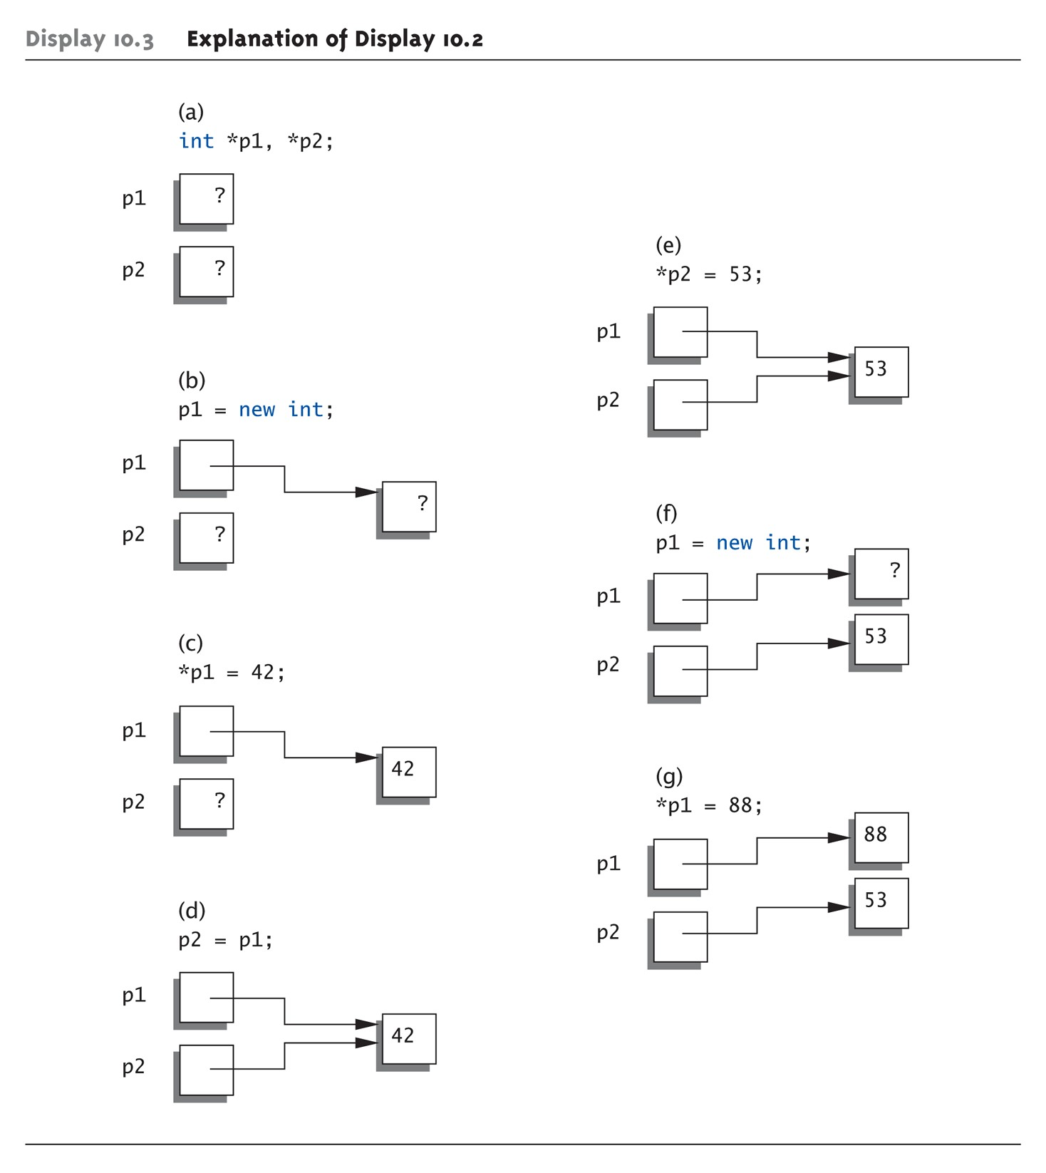
Basic Pointer Manipulations Graphic:
1-15

Slide 16
More on new Operator
Creates new dynamic variable
Returns pointer to the new variable
If type is class type:
Constructor is called for new object
Can invoke different constructor with initializer arguments:
MyClass *mcPtr;
mcPtr = new MyClass(32.0, 17);
Can still initialize non-class types:
int *n;
n = new int(17); //Initializes *n to 17
1-16

Slide 17
Array Declarations
declaration by initializing elements int arr[] = { 1, 2, 3, 4 }
declaration by specifying size and initializing elements int arr[6] = { 1, 2, 3, 4 }
1-17

Slide 18
Arrays with range based and for
#include <iostream> using namespace std; int main() {
int numbers[5] = {7, 5, 6, 12, 35}; cout << "The numbers are: ";
for (const int &n : numbers) { cout << n << " ";
}
cout << "\nThe numbers are: "; for (int i = 0; i < 5; ++i) {
cout << numbers[i] << " ";
}
return 0;
}
19

Slide 19
Dangling Pointers
delete p;
Destroys dynamic memory
But p still points there!
- Called "dangling pointer"
Avoid dangling pointers
Assign pointer to NULL after delete:
delete p; p = NULL;
1-19

Slide 20
Array Variables
Recall: arrays stored in memory addresses, sequentially
Array variable "refers to" first indexed variable
So array variable is a kind of pointer variable!
Example: int a[10]; int * p;
a and p are both pointer variables!
1-20

Slide 21
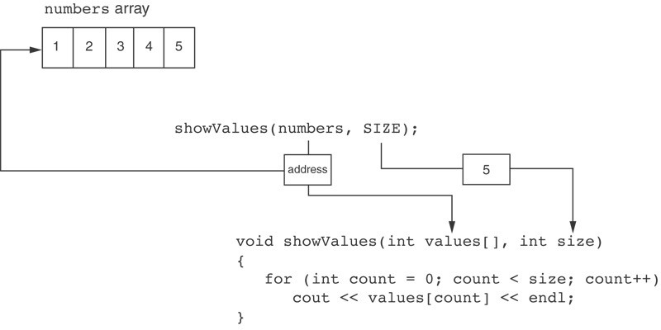
Something Like Pointers : Arrays
showValues(numbers, SIZE);

Slide 22
Something Like Pointers: Reference Variables
void getOrder(int &donuts)
{
cout << "How many doughnuts do you want? "; cin >> donuts;
}
And we call it with this code: int jellyDonuts; getOrder(jellyDonuts);

Slide 23
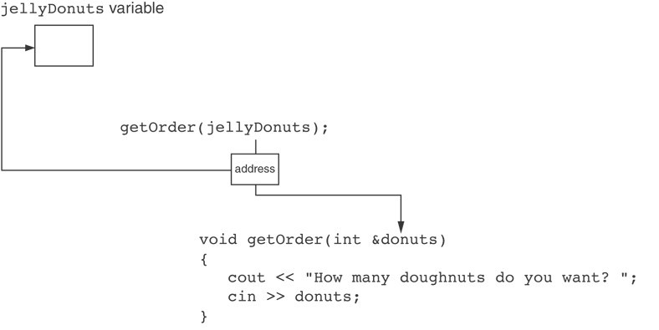
void getOrder(int &donuts)
{
cout << "How many doughnuts do you want? "; cin >> donuts;
}
And we call it with this code:
int jellyDonuts; getOrder(jellyDonuts);
The donuts parameter, in the getOrder function, points to the jellyDonuts variable.
C++ automatically stores the address of jellyDonuts in the donuts parameter.
24

Slide 24
Back to Classes
The -> operator
Shorthand notation
Example:
MyClass *p;
p = new MyClass;
p->grade = "A"; Equivalent to: (*p).grade = "A";
1-24

Slide 25
The this Pointer
Member function definitions might need to refer to calling object
Use predefined this pointer
Automatically points to calling object:
Class Simple
{
public:
void showStuff() const; private:
int stuff;
};
Two ways for member functions to access:
cout << stuff;
cout << this->stuff;
1-25

Slide 26
Overloading Assignment Operator
Assignment operator returns reference
So assignment "chains" are possible
e.g., a = b = c;
- Sets a and b equal to c
Operator must return "same type" as it’s left-hand side
To allow chains to work
The this pointer will help with this!
1-26

Slide 27
Overloading Assignment Operator
Recall: Assignment operator must be member of the class
It has one parameter
Left-operand is calling object s1 = s2;
- Think of like: s1.=(s2);
s1 = s2 = s3;
Requires (s1 = s2) = s3;
So (s1 = s2) must return object of s1"s type
- And pass to " = s3";
1-27

